Slide 1
Accessibility & Augmented Reality
IGDA Game Accessibility SIG
Open Educational Resources (OER) Project
These slides were provided by Things Entertainment, LLC
http://www.thingsentertainment.net
Notes:
Things Entertainment first shared these techniques, and a demo illustrating their use, at the VR for Good Summit in Washington DC, which was held on November 17, 2017 at the Milken Institute School of Public Health, George Washington University.

Slide 2
Accessibility of this Presentation
This presentation has been developed with accessibility of the presentation itself in mind.
When editing the presentation the two most important steps to take to maintain accessibility are making sure the alt-text still makes sense and making sure the reading order is still correct.
For information on how to do this, visit this Microsoft Support Topic.

Slide 3
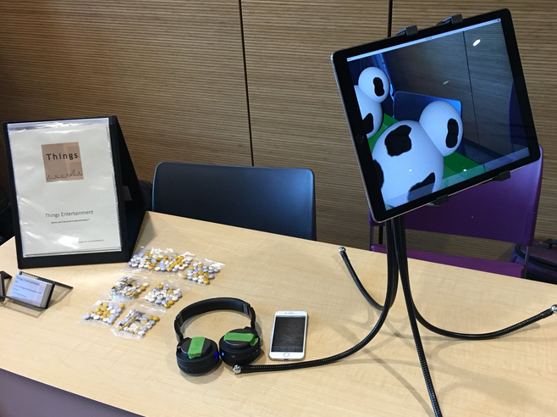
What is Augmented Reality (AR)?
In Augmented Reality applications, some device is used to experience enhancements to the real world.
Much work in augmented reality is focused on visual effects, but the enhancements can also be haptic (something that is felt) or auditory.

Slide 4
What is Accessibility?
Developing software, games, Web sites and documents so they can be used by people with disabilities.
Learn more at:
Game Accessibility Guidelines
Includification
The Web Accessibility Initiative (W3C)
Many existing accessibility guidelines apply directly or with slight modification to augmented reality games/software.
Only techniques that are specific to augmented reality (new) are discussed in this OER.

Slide 5
Users to consider
All AR games can work well for at least some users with disabilities.
Not all AR games will work well for all users, but some games will work well for all users.
Notes:
All games can work well for at least some of these users. Not all games will work well for all users, but some games will work well for all users.

Slide 6
Users to Consider
Users using Mono-Audio
Deaf Users
Blind Users
Low Vision Users
Cognitively Impaired Users
Wheel Chair Users
Users of above or below average height
Users who have trouble bending
Mono-vision
Color-Blind Users
Users Who Need to Avoid Flashing/Blinking Content
Mobility Impaired Users
Users with Dexterity Issues
Users who have trouble looking behind them
Deaf-Blind Users
Users in situations that mimic these issues
Notes:
Situations that mimic these issues include looking at a screen in bright sun or playing on an airplane where you can’t move around as much.

Slide 7
Users at Greatest Risk of Being Left Out of AR
Those with visual impairments
Those with both hearing/vision impairments
Those with mobility impairments
Notes:
Situations that mimic these issues include looking at a screen in bright sun or playing on an airplane where you can’t move around as much.

Slide 8
About the Techniques We’ll Discuss
These techniques are designed to help make augmented reality accessible to people with disabilities.
They may also make augmented reality more engaging and realistic to a general audience.
Not all of these techniques will be appropriate for every augmented reality game or application.

Slide 9
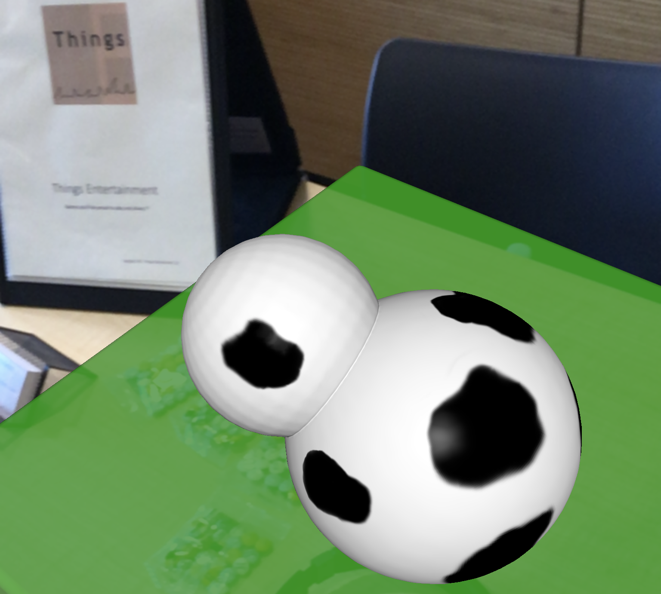
Emerging Technologies & Accessibility
Emerging technologies are often an opportunity to innovate for accessibility
These techniques are a work in progress
Notes:
Every technique listed has been implemented in at least one test application by Things Entertainment on at least one reasonably priced current platform.

Slide 10
Spatial or Positional Sound Effects
Guideline
Benefits
Provide sounds that sound as though they are coming from the location of augmented reality objects in the real world using stereo or surround sound. Sounds can be obvious, subtle and/or only present or only emphasized based on certain user settings.
General audience: Increases realism
People with mobility impairments: Reduces the amount of movement needed to locate objects
People who are blind or have low vision: Makes game play functional with less reliance on text descriptions

Slide 11
Distance Interactive Sound Effects / Distance Interactive Haptics
Guideline
Benefits
Play audio cues or haptic cues when a real world device or a real world controller is pointed precisely at an augmented reality object (target) in real world space.
General audience & people with low vision: Provides user feedback and helps confirm game play targets when item is difficult to see or game play is very fast
People who are blind or have low vision: Makes game play functional by providing artificial line of sight

Slide 12
Types of precise pointing include:
Use of controller (like a laser pointer)
Tapping or panning on a touch screen as secondary precise positioning technique to narrow down location, if another method is provided for less precise positioning
Panning with a touch screen itself (moving the device)
Combinations of the above for more and less precise positioning
Notes:
Several possible types of precise pointing are listed on this slide.
For greater realism, distance interactive sounds can also be spatial or positional and sound like they come from the target.

Slide 13
Real World Location Haptics / Real World Location Sound Effects
Guideline
Benefits
Play haptic cues or audio cues when a real world device or a real world controller intersects with an augmented reality object in real world space.
General audience: Increases realism
People who are blind: Provides an experience of augmented reality
People who are blind or have low vision: Makes game play functional with less reliance on text descriptions
Notes:
Note that in practical coding you might be testing for intersection with a point in space slightly outside of the actual location of the real world device or the real world controller.

Slide 14
Adjustable Location of Augmented Reality Objects for Easy Access
Guideline
Benefits
Allow users to move augmented reality objects that they need to interact with to be lower (e.g. for wheelchair access), to be higher (e.g. to avoid bending), and/or to be closer (reduce motion needed).
General audience: Ease of use for games with "grind". More pleasant/faster game-play for advanced players in sandbox games.
Smaller-space players: Makes it possible to move augmented reality objects that might be inaccessible because they appear in the same space as real world objects (such as a wall).
People with mobility impairments: Reduces the amount of movement and the types of movement needed to play
People who are blind or have low vision: Makes it possible to reduce the real world field of play, making location tasks simpler

Slide 15
Avoid Space Conflicts
Guideline
Benefits
Avoid precisely matching the position and size of augmented reality objects with the position and size of real world objects.
General audience, Smaller-space players & People with mobility impairments: Avoids inaccessible augmented reality objects after adjustments are made for guideline 4.
People with mobility impairments: Increases options in the type of movement, the angle of movement and the direction of movement needed to interact with augmented reality objects, because it is possible to move through augmented reality objects, while real world objects block motion
Notes:
For example, it is good practice for augmented reality horizontal planes (e.g. tables, desks) to overhang any real world horizonal planes that they may be imitating.

Slide 16
Further Resources

Slide 17
Articles & Presentations on AR and VR Accessibility
Augmented Reality and Accessibility from Tecla
Virtual and Augmented Reality Accessibility from Accessibility NYC
Making VR and AR Truly Accessible from Game Developer’s Conference
Accessibility for AR and VR from Google I/O ‘18

Slide 18
Additional Open Educational Resources (OER)
Look out for more and future OERs from the Game Accessibility Special Interest Group of the International Game Developers Association here:
https://igda-gasig.org/oer/

