Slide 1
Accommodating Players who are Color Blind in Your Game Software
IGDA Game Accessibility SIG
Open Educational Resources (OER) Project
These slides were provided by Things Entertainment, LLC
http://www.thingsentertainment.net

Slide 2
Accessibility of this Presentation
This presentation has been developed with accessibility of the presentation itself in mind.
When editing the presentation the two most important steps to take to maintain accessibility are making sure the alt-text still makes sense and making sure the reading order is still correct.
For information on how to do this, visit this Microsoft Support Topic.

Slide 3
Color blindness is fairly common
About 8% of males*
About 0.5% of females*
*According to ColourBlindAwareness.org and Color-Blindness.com
Notes:
Sources:
http://www.colourblindawareness.org/colour-blindness/
http://www.color-blindness.com/50-facts-about-color-blindness/

Slide 4
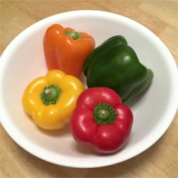
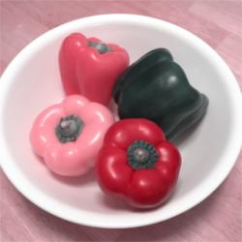
People who are “Color Blind” see different ranges of Colors
Average
Color Blind
Seeing no color (e.g. seeing in greyscale) is
extremely rare.
Notes:
Sources:
Image curtesy of Things Entertainment, LLC (http://www.thingsentertainment.net)
Simulation created using Entre’s Colour Blindness Simulator available at http://www.etre.com/tools/colourblindsimulator/
The first simulation uses the Deuteranopia tool.
The second simulation uses the Protanopia tool.

Slide 5
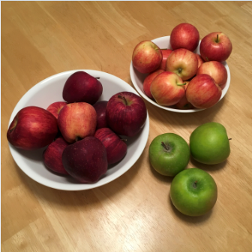
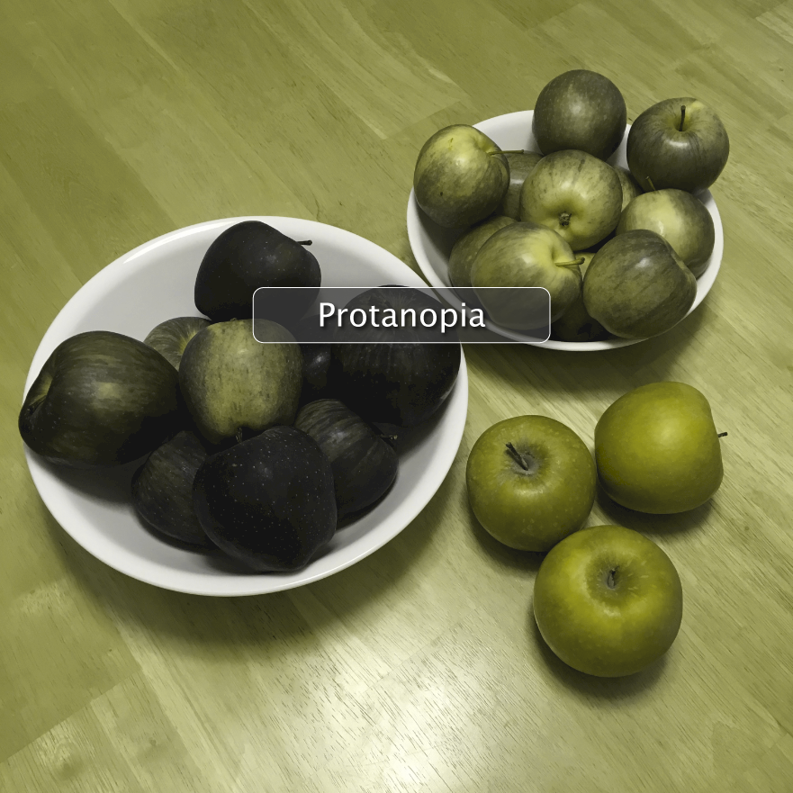
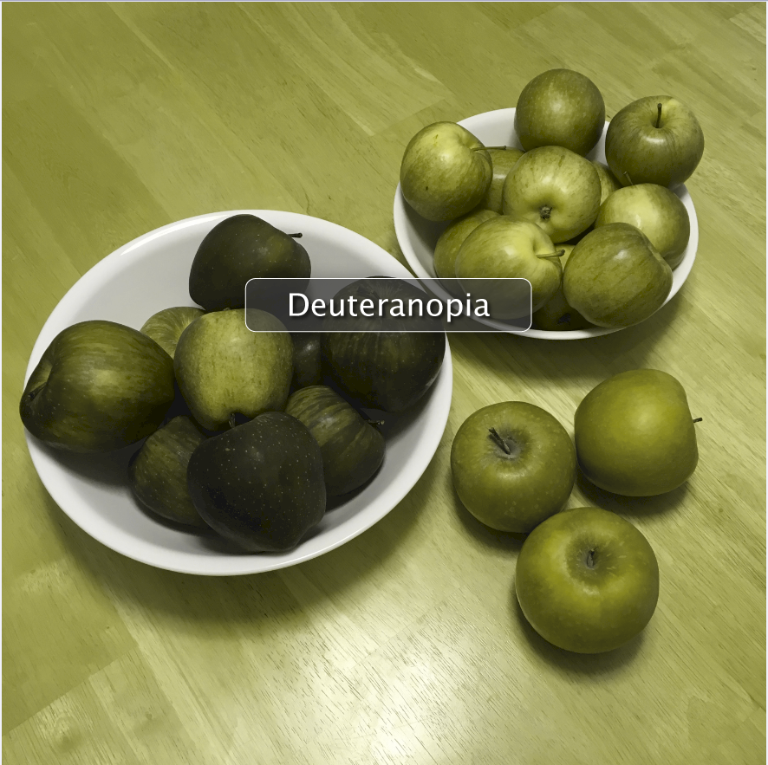
There is variation in how different people with color blindness see colors.
A game may work fine for one person with color-blindness, but not for others with color-blindness.
Average
Tritanopia
Protanopia
Deuteranopia
Notes:
Sources:
Images curtesy of Things Entertainment, LLC (http://www.thingsentertainment.net)
Simulations created using Color Oracle from http://colororacle.org/

Slide 6
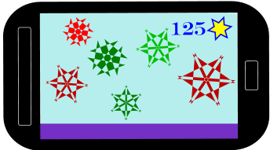
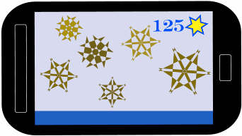
Deuteranopia
Average
Most common
Red/Green
Including a more mild variation called Deuteranomoly: 5% of all males according to ColorOracle.org
Notice the blue and purple both look blue
Simulated
Notes:
Sources:
Statistics from http://colororacle.org/usage.html
Image curtesy of Things Entertainment, LLC (http://www.thingsentertainment.net)
Simulation created using The Paciello Group’s Colour Contrast Analyser available at https://developer.paciellogroup.com/resources/contrastanalyser/

Slide 7
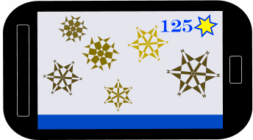
Protanopia
Average
Notice the reds don’t just have a different hue, but are also a little darker
Including a more mild version called Protanomaly: 2.5% of all males according to ColorOracle.org
Simulated
Notes:
Sources:
Statistics from http://colororacle.org/usage.html
Image curtesy of Things Entertainment, LLC (http://www.thingsentertainment.net)
Simulation created using The Paciello Group’s Colour Contrast Analyser available at https://developer.paciellogroup.com/resources/contrastanalyser/

Slide 8
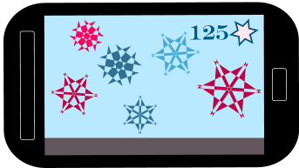
Tritanopia
Average
Notice the yellow inside the star looks pink
Under 0.3% of all people, according to ColorOracle.org
Simulated
Notes:
Sources:
Statistics from http://colororacle.org/usage.html
Image curtesy of Things Entertainment, LLC (http://www.thingsentertainment.net)
Simulation created using The Paciello Group’s Colour Contrast Analyser available at https://developer.paciellogroup.com/resources/contrastanalyser/

Slide 9
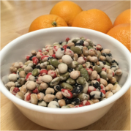
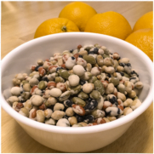
Color Blindness can be Mild
You may have players who don’t know they have color blindness and so would not think to select color blindness settings in your game.
Average
Green-Weak / Deuteranomaly
Green-Blind / Deuteranopia
Notes:
Sources:
Images curtesy of Things Entertainment, LLC (http://www.thingsentertainment.net)
Simulations created using Coblis from http://www.color-blindness.com available at http://www.color-blindness.com/coblis-color-blindness-simulator/
http://www.colourblindawareness.org/colour-blindness/ - Quotation from this page: “approximately 40% of colour blind pupils currently leaving secondary school are unaware that they are colour blind”

Slide 10
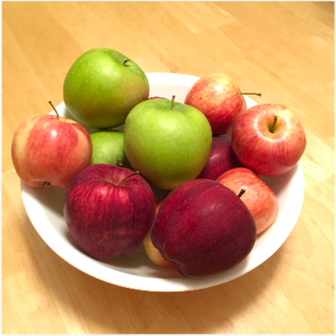
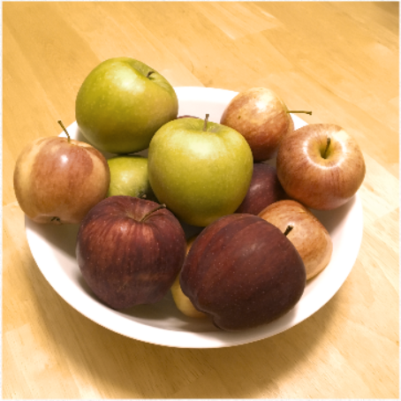
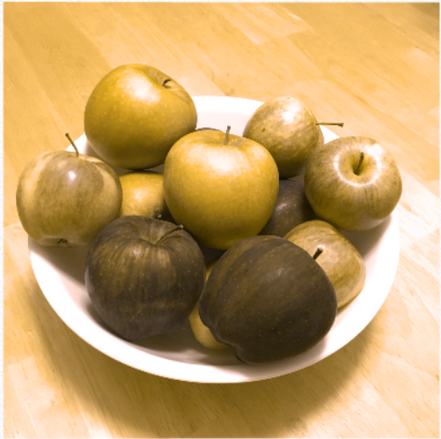
Range
People with the most common form of color blindness range from nearly average vision to vision like that shown in the Deuteranopia simulation
Average
Green-Weak / Deuteranomaly
Green-Blind / Deuteranopia
Notes:
Sources:
Images curtesy of Things Entertainment, LLC (http://www.thingsentertainment.net)
Simulations created using Coblis from http://www.color-blindness.com available at http://www.color-blindness.com/coblis-color-blindness-simulator/
http://www.color-blindness.com/50-facts-about-color-blindness/ - Quotation from this page: “#17 There exists every nuance of color vision deficiency severity, starting from almost normal color vision up to complete color blindness.”

Slide 11
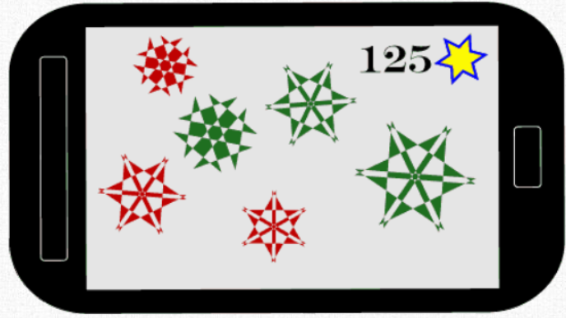
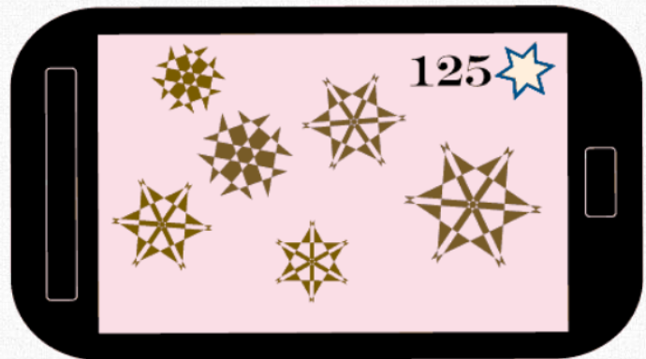
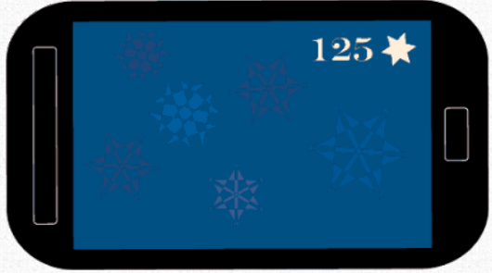
Consider both:
Difficulty distinguishing items from each other:
Difficulty distinguishing items from the background:
Simulated
Simulated
Notes:
Sources:
Images curtesy of Things Entertainment, LLC (http://www.thingsentertainment.net)
Simulations created using Coblis from http://www.color-blindness.com available at http://www.color-blindness.com/coblis-color-blindness-simulator/
Both simulations use the Green-Blind/Deuteranopia simulation, which is the most common form of color blindness

Slide 12
Formal Guidelines - Software
WCAG 2.0 Level AA - https://www.w3.org/TR/WCAG20/
“1.4.1 Use of Color: Color is not used as the only visual means of conveying information, indicating an action, prompting a response, or distinguishing a visual element. (Level A)”
“1.4.3 Contrast (Minimum): The visual presentation of text and images of text has a contrast ratio of at least 4.5:1, except for the following: (Level AA)
Large Text: Large-scale text and images of large-scale text have a contrast ratio of at least 3:1;
Incidental: Text or images of text that are part of an inactive user interface component, that are pure decoration, that are not visible to anyone, or that are part of a picture that contains significant other visual content, have no contrast requirement.
Logotypes: Text that is part of a logo or brand name has no minimum contrast requirement.”

Slide 13
Formal Guidelines - Software
WCAG 2.1 Level AA - https://www.w3.org/TR/WCAG20/
“1.4.11 Non-text Contrast: The visual presentation of the following have a contrast ratio of at least 3:1 against adjacent color(s):
User Interface Components: Visual information required to identify user interface components and states, except for inactive components or where the appearance of the component is determined by the user agent and not modified by the author;
Graphical Objects: Parts of graphics required to understand the content, except when a particular presentation of graphics is essential to the information being conveyed.”

Slide 14
Formal Guidelines - Games
Game Accessibility Guidelines
Includification
“Ensure no essential information is conveyed by a fixed colour alone”
“Provide high contrast between text/UI and background”
“Provide a choice of cursor / crosshair colours / designs”
“Provide an option to adjust contrast”
“Changeable Text Colors”
“Color-Blind Options”
“High-contrast Target Reticle”
“Enemy Marking”
“Map Recoloring Options / Alternative Views”

Slide 15
Types of Techniques
Default Design: Incorporate solutions into the design
Color-blind Mode(s): For example, a color blind mode where symbols are used instead of color
Customization Options: For example, letting the player choose the colors for key items

Slide 16
1. Default Design
Advantage: Users don’t have to select special options

Slide 17
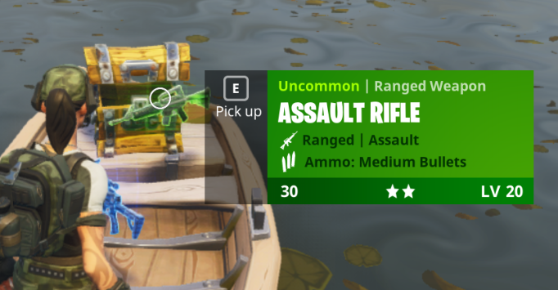
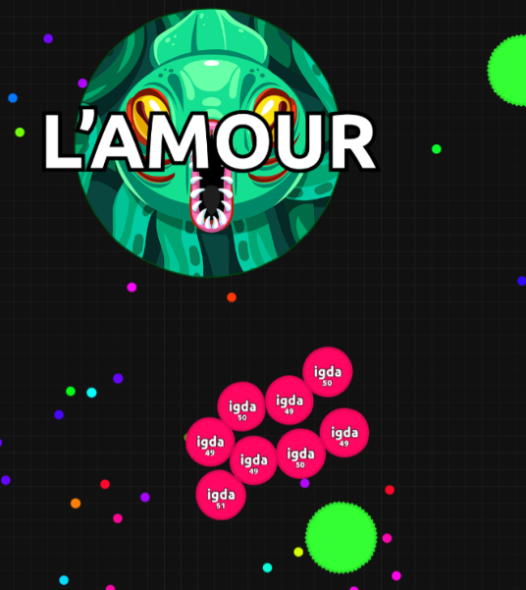
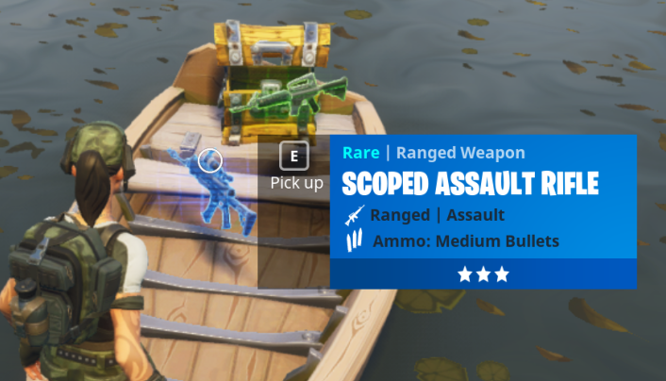
Labels
Fortnight uses Pop-up Windows to Label Color-Coded Weapons
Agar.io uses labels in addition to colors to show which circles belong to which players
Notes:
The best implementations seem completely natural and part of the overall design.

Slide 18
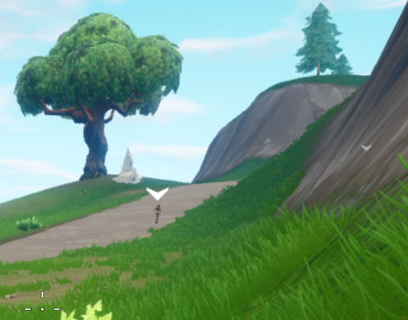
Other Visual Symbols
Fortnight uses a symbol instead of color to differentiate friendly avatars
Fortnight uses stars in addition to color to indicate weapon quality
Notes:
The redundancy of the colors and the stars in the Equipment panel also helps all users to understand the color coding.

Slide 19
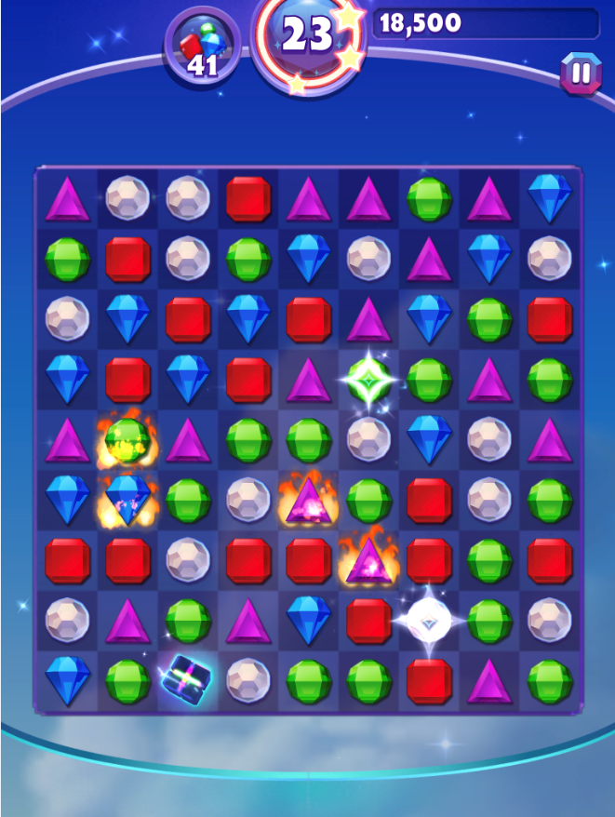
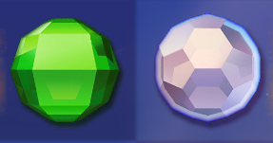
Technique: Differing Shapes &/or Textures
Bejeweled Stars’ native design
Different Shapes
If shape is the same, texture is very different:

Slide 20
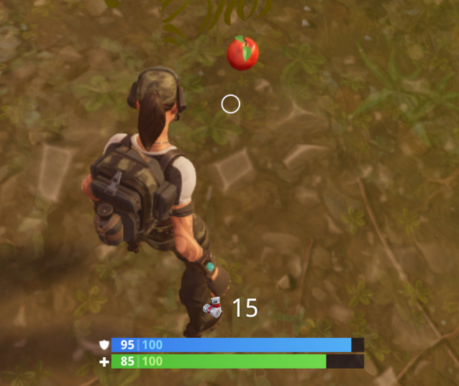
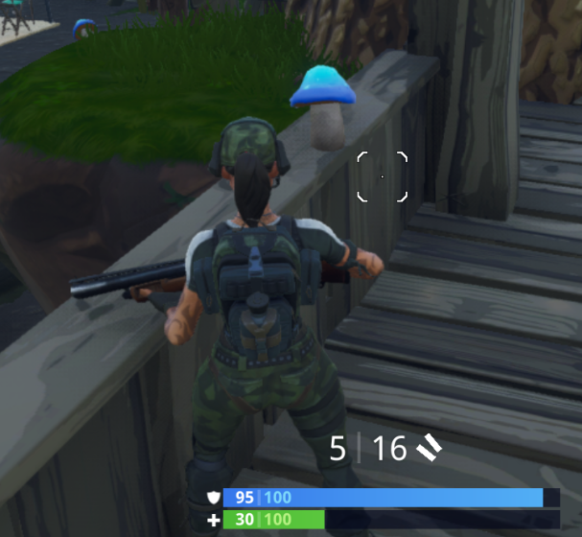
Technique: Differing Shape
The apples and mushrooms in Fortnight could have just been differently colored potion bottles.
The best implementations seem like delightful original design, not like addons.
Perhaps this was just good native design.

Slide 21
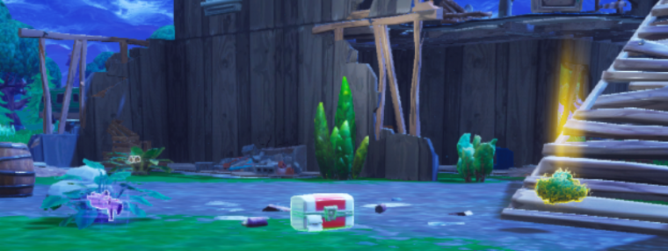
Technique: Different Patterns or Textures
Notes:
A colored glow is used to indicate the value of loot items in Fortnight. Shown are green, purple and gold. Gold is the most valuable of the group. Green is the least. In addition to color, the amount and type of glow also varies.

Slide 22
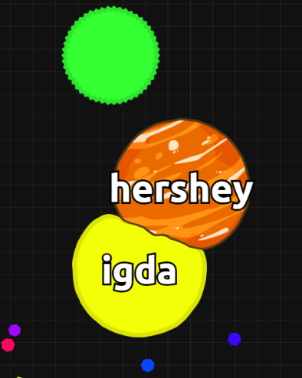
Use Dual Colors when background is unpredictable
Agar.io’s native design
Notes:
Agar.io uses white text outlined in black to label circles for which users can choose from a variety of skins

Slide 23
2. Color-blind Mode(s)
Advantage: Doesn’t impact default design

Slide 24
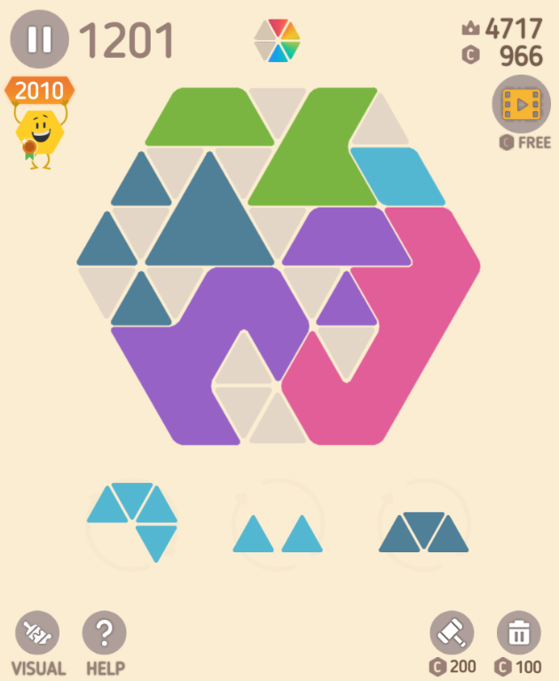
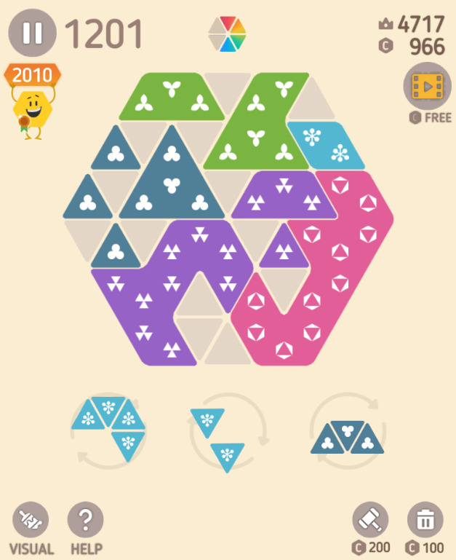
Make Hexa’s Symbol Mode

Slide 25
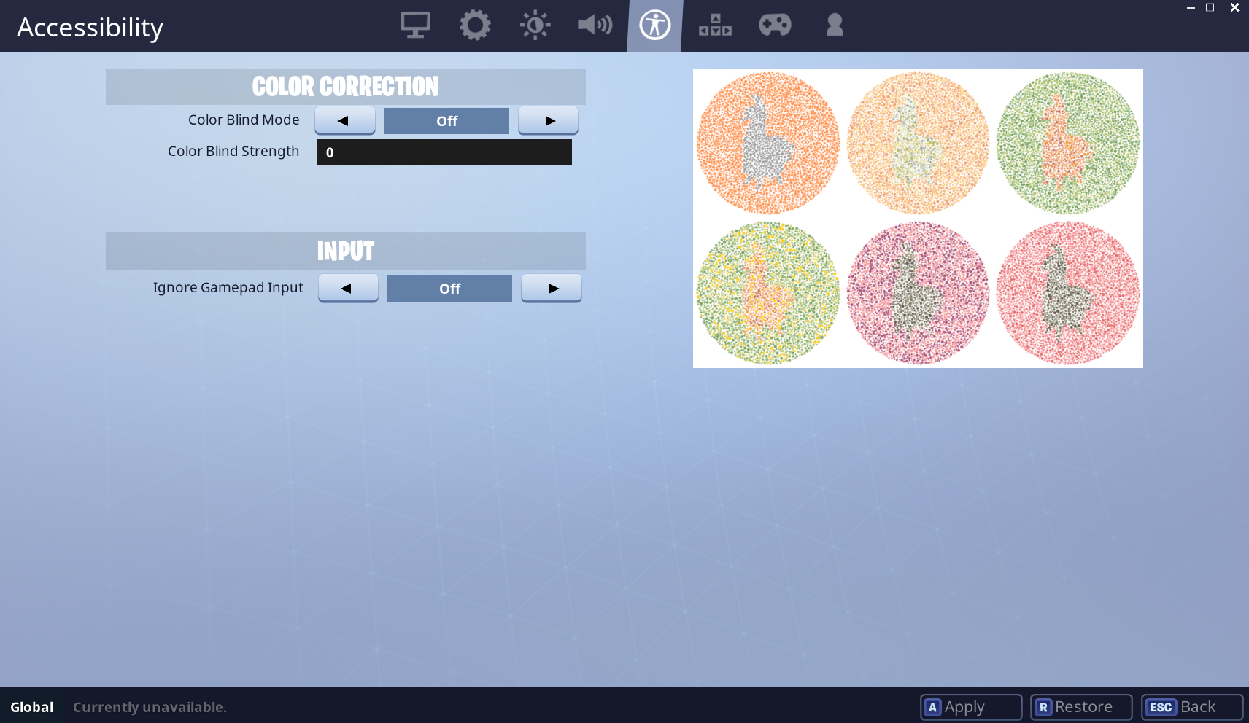
Fortnight – Options Screen Color Correction Filters
Affects full visual experience
Can seem unnatural to users
But, especially when you have also used other indicators in addition to color, as in Fortnight, adding this for another option to adjust visuals can help level the playing field in a highly visual game

Slide 26
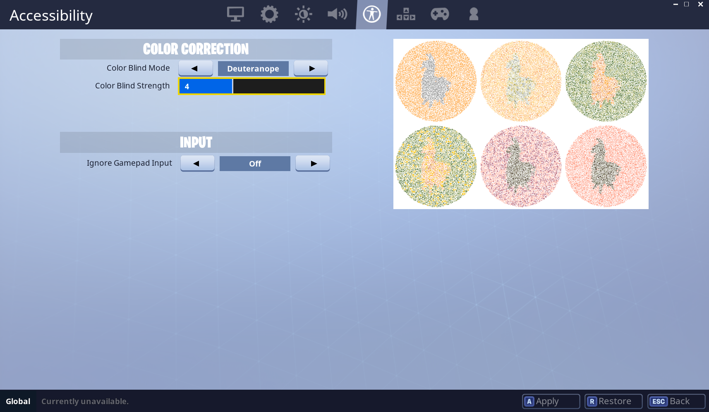
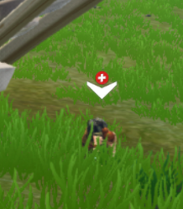
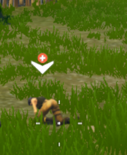
Fortnight – Deuteranope 4
Notes:
In the Deuteranope color scheme, the red indicator that a teammate needs help is lighter and so stands out better from the often-green background. Another option would be to just provide the ability to adjust colors for key items like this, so that the full game color palette would not need to change. In this case, because of the plus, the symbol is visible regardless, so users don’t have to use the color blind mode if they prefer not to.

Slide 27
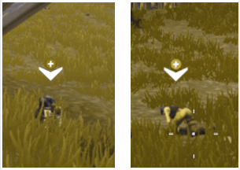
Fortnight – Deuteranope 4
Simulated
Notes:
In the Deuteranope color scheme, the red indicator that a teammate needs help is lighter and so stands out better from the often-green background. Another option would be to just provide the ability to adjust colors for key items like this, so that the full game color palette would not need to change. In this case, because of the plus, the symbol is visible regardless, so users don’t have to use the color blind mode if they prefer not to.

Slide 28
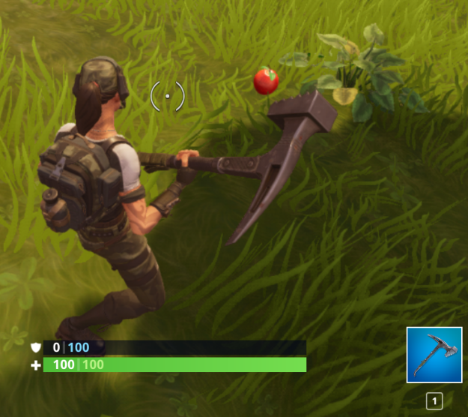
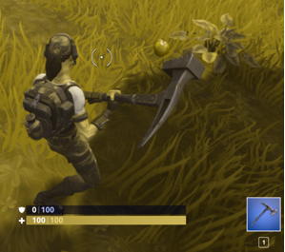
Fortnight – Spotting an Apple
Average
Deuteranopia Simulation
Notes:
Fortnight – Deuteranope 10

Slide 29
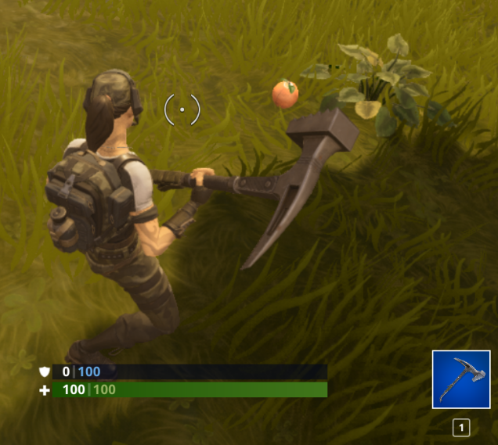
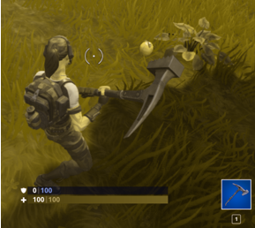
Fortnight – Spotting an Apple with Color-blind Mode Set
Average
Deuteranopia Simulation
Notes:
Fortnight – Deuteranope 10

Slide 30
Comparable Experience
Average Vision without a Filter
Deuteranopia Simulation with Filter
Notes:
Fortnight – Deuteranope 10

Slide 31
3. Customization Options
Advantage: Allows a greater range of accommodation and may be useful to those with other vision impairments as well

Slide 32
Customization Options: Specific to Your Game
Identify key elements that might be difficult to see
The formal guidelines mention crosshairs and mini maps, but look out for the key elements in your game.
Test with simulators
If possible, test with actual colorblind users
Provide settings that let colorblind users choose the colors for key game elements.
Consider offering other customizations as well, such as size or glow

Slide 33
Customization Options: Honor Device Settings
See if the operating systems that you support offer color blindness settings
See if these settings impact your game without any action from you
Test & Document
Make sure the settings work well with your game
Document results for users
Consider responding in other ways if your users have these settings set
Additional color changes
Alerting the user to additional settings

Slide 34
Resources

Slide 35
Color Blindness Simulators
http://colororacle.org/
http://www.etre.com/tools/colourblindsimulator/
https://developer.paciellogroup.com/resources/contrastanalyser/
http://www.color-blindness.com/coblis-color-blindness-simulator/

Slide 36
More Accessibility Guidelines
These slides cover color blindness specifically.
Color blindness sometimes occurs with other conditions, such as mild visual impairment and low vision.
There are guidelines in the Game Accessibility Guidelines that cover a variety visual impairments
Hearing, cognitive and mobility impairments are also discussed
http://gameaccessibilityguidelines.com
https://www.includification.com/

Slide 37
Additional Open Educational Resources (OER)
Look out for more and future OERs from the Game Accessibility Special Interest Group of the International Game Developers Association here:
https://igda-gasig.org/oer/

