Slide 1
Unified design of computer games HCI
– an introduction.
IGDA Game Accessibility SIG
Open Educational Resources (OER) Project
These slides were provided by Thomas Westin 2018

Slide 2
Overview
Unified design, introduction
Unified design, applied on Asteroids for workshop
Based upon research by Grammenos, Savidis & Stephanidis (2007)

Slide 3
Unified Design, five steps
Abstract Task Decomposition (premade in this exercise)
Polymorphic Specialization with Design Alternatives (premade here)
Appropriateness Analysis for Design Alternatives
User profile Analysis
Compatibility Analysis of Design Alt. (not in this exercise)
(After: Prototyping, Usability, Accessibility Evaluation)
See: Grammenos, D., Savidis, A. & Stephanidis, C. 2007. Unified Design of Universally Accessible Games. Universal Access in Human-Computer Interaction. Applications and Services, 2007. 607-616.

Slide 4
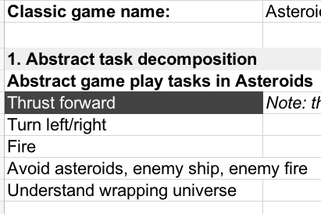
1. Abstract Task Decomposition
Asteroids:
List which game play tasks are done to play the game? Select one.

Slide 5
2. Polymorphic Specialization with Design Alternatives
Asteroids:
Which I/O design alternatives may be used for the game mechanics?

Slide 6
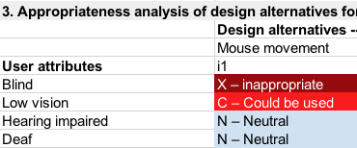
3. Appropriateness analysis
Asteroids:
For who are which design alternatives appropriate?

Slide 7
4a Merge attributes to a user profile
If a DA is X – Inappropriate for any attribute → consider the DA X for entire profile
If a DA is N – Neutral for a specific attribute→ då påverkas inte designens appropriateness av det
If a DA is I – Ideal, A – appropriate, C – could be used → lowest applies
(Grammenos et al 2007)

Slide 8
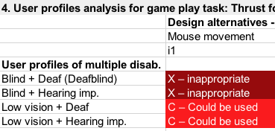
4b User profile, example
Asteroids:

Slide 9
FAQ
Q: How should the Design Alternatives be interpreted?
A: Each Design Alternative (DA) should be understood as exclusive other DAs. E.g. if a DA is named Speech output, then it should be evaluated as if there is only Speech output. If you have multimodal output you need to name the DA accordingly, e.g. Speech+SoundEffect output.
Q: How should the User Attributes be interpreted?
A: Each User Attribute (UA) should be understood as exclusive other UAs. E.g. if the UA is Low Vision, it is only Low vision that should be evaluated. The user is assumed to have no other impairments.
Q: How to handle multiple user attributes?
A: This is done with User Profiles
Q: How to select between nearby appropriateness levels? For instance, between Ideal and Could be used?
A: This is sometimes hard and there is no simple answer. It all comes down to the motivation of your choice, which should be well-grounded at least in research and preferably by involving gamers with disabilities. Remember that the appropriateness depends on design alternatives, user attributes, and game mechanics, and thus also unique per game.

Slide 10
References
Grammenos, D., Savidis, A. & Stephanidis, C. 2007. Unified Design of Universally Accessible Games. Universal Access in Human-Computer Interaction. Applications and Services, 2007. 607-616.

